Slide 1
CAP275: Data Communication and Networking
Physical Layer-1
By Dr. Sanjeev Kumar Mandal

Slide 2
What is a Signal?
A signal is an electromagnetic or electrical current that is used for carrying data from one system or network to another.
What is an Analog Signal?
An analog signal is a continuously varying electromagnetic wave that may be propagated over a variety of media, depending on frequency; examples are copper wire media, such as twisted pair and coaxial cable; fiber optic cable; and atmosphere or space propagation (wireless).
What is a Digital Signal?
A digital signal is a signal that is used to represent data as a sequence of separate values at any point in time. It can only take on one of a fixed number of values.

Slide 3
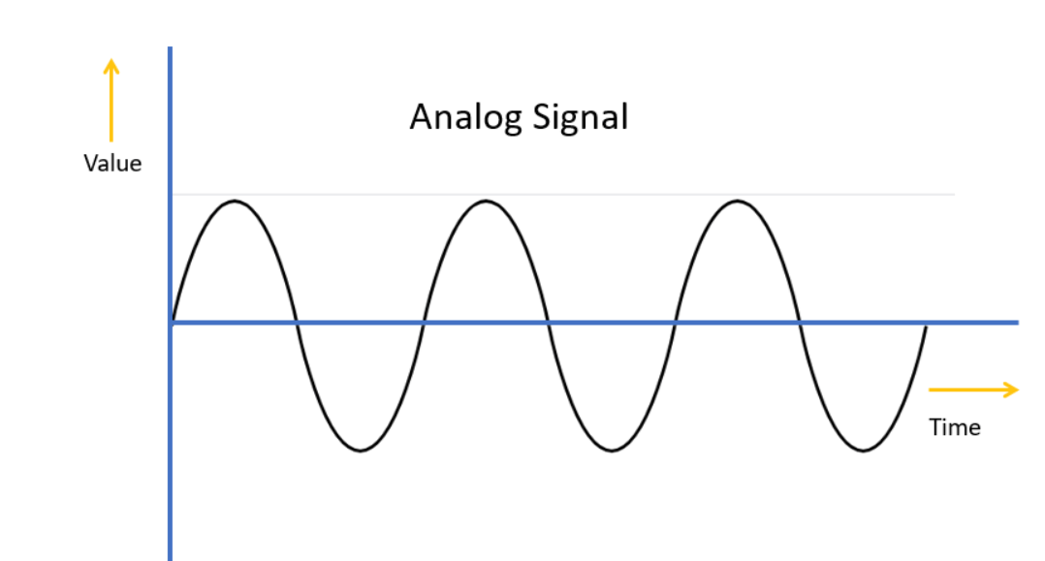
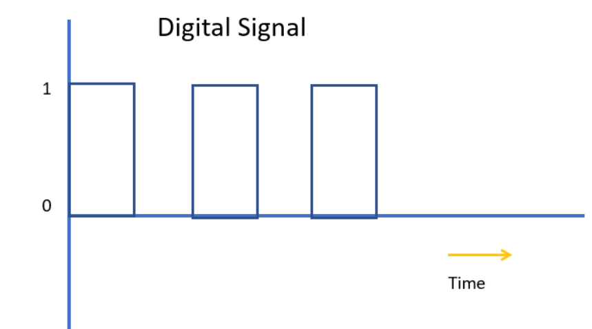

Slide 4
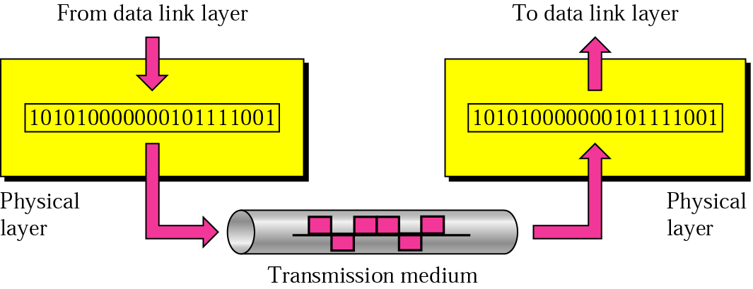

Slide 5
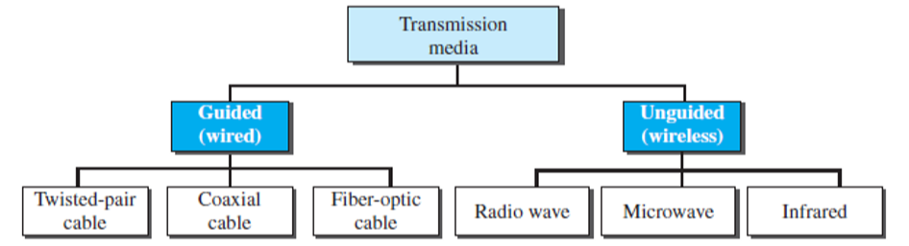
TRANSMISSION MEDIA (contd…)
In telecommunications, transmission media can be divided into two broad categories: guided and unguided.
Guided media include twisted-pair cable, coaxial cable, and fiber-optic cable.
Unguided medium is free space.

Slide 6
FACTORS TO BE CONSIDERED WHILE CHOOSING TRANSMISSION MEDIUM
Transmission Rate
Cost and Ease of Installation
Resistance to Environmental Conditions
Distances

Slide 7
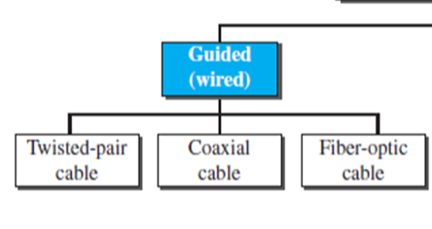
GUIDED MEDIA
Guided media, which are those that provide a conduit from one device to another, include twisted-pair cable, coaxial cable, and fiber-optic cable.

Slide 8
TWISTED PAIR CABLE
This cable is the most commonly used and is cheaper than others. It is lightweight, cheap, can be installed easily, and they support many different types of network.
A twisted pair consists of two conductors (normally copper), each with its own plastic insulation, twisted together, as shown.

Slide 9
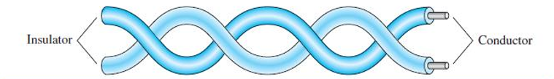
TWISTED PAIR CABLE (contd…)
Fig. : Twisted-Pair Cable.

Slide 10
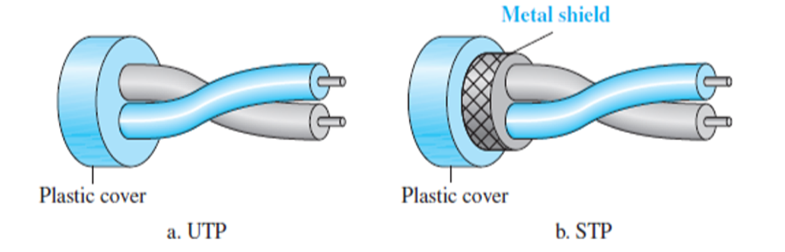
UTP AND STP CABLES
Twisted Pair is of two types :
Unshielded Twisted Pair (UTP)
Shielded Twisted Pair (STP) - STP cable has a metal foil or braided mesh covering that encases each pair of insulated conductors.

Slide 11
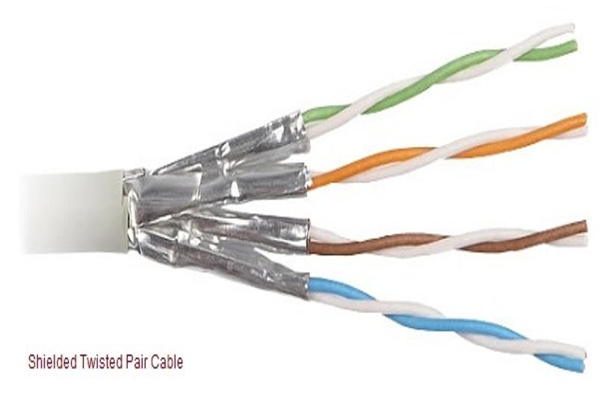
UNSHIELDED TWISTED PAIR (UTP)
Adv:
• Ordinary telephone wire
• Cheapest
• Easiest to install
• It has high speed capacity
• 100 meter limit
Disadv:
• Bandwidth is low when compared with Coaxial Cable
• Provides less protection from interference.

Slide 12
SHIELDED TWISTED PAIR (STP)
Advantages:
Metal braid or sheathing that reduces interference
Easy to install
Eliminates crosstalk
Higher capacity than unshielded twisted pair
Increases the signaling rate
Disadvantages:
More expensive
Harder to handle (thick, heavy)
Difficult to manufacture

Slide 13
TWISTED PAIR CABLE APPLICATIONS
Twisted-pair cables are used in telephone lines to provide voice and data channels.
The local loop—the line that connects subscribers to the central telephone office— commonly consists of unshielded twisted-pair cables.
The DSL lines that are used by the telephone companies to provide high-data-rate connections also use the high-bandwidth capability of unshielded twisted-pair cables.
Local-area networks, such as 10Base-T and 100Base-T, also use twisted-pair cables.

Slide 14
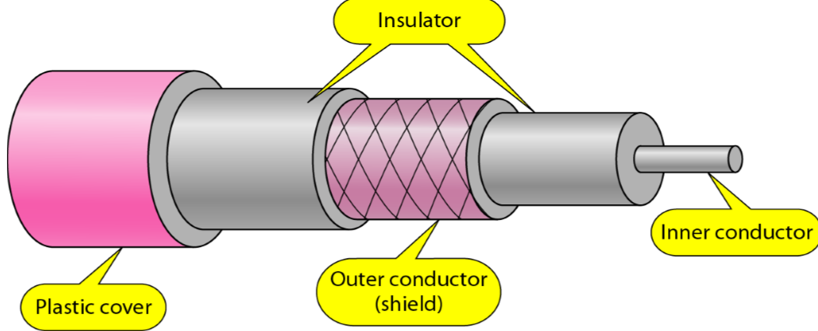
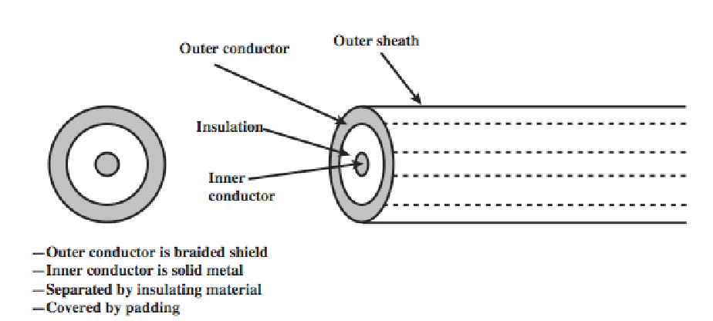
GUIDED MEDIA – COAXIAL CABLE

Slide 15
TYPES OF COAXIAL CABLES
Baseband:
Which is used for digital transmission. It is mostly used for LAN’s. Baseband transmits a single signal at a time with very high speed.
Broadband:
This uses analog transmission on standard cable television cabling It transmits several simultaneous signal using different frequencies.

Slide 16
COAXIAL CABLE (contd…)
Applications
Analog telephone networks
Cable TV networks
Traditional Ethernet LAN – 10Base2, 10Base5

Slide 17
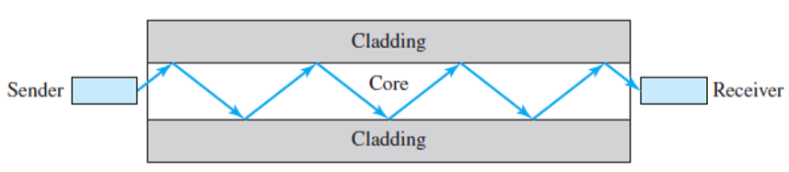
FIBER-OPTIC CABLE
Higher bandwidth
Less expensive
Immune to electrical noise
More secure – easy to notice an attempt to intercept signal
Physical characterizes
Glass or plastic fibers
Very thin (thinner than human hair)
Material is light

Slide 18
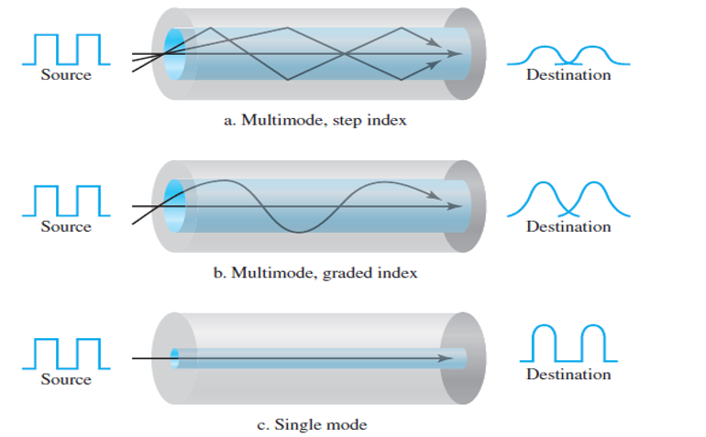
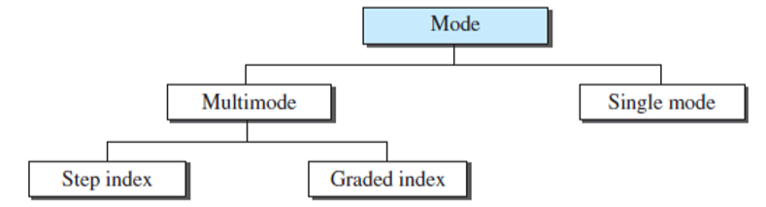
FIBER-OPTIC CABLE (contd…)
Propagation modes

Slide 19
ADVANTAGES AND DISADVANTAGES OF OPTICAL FIBER
Advantages:
Higher bandwidth
Less signal attenuation
Immunity to electromagnetic interference
Resistance to corrosive materials
Light weight
Greater immunity to tapping

Slide 20
ADVANTAGES AND DISADVANTAGES OF OPTICAL FIBER (contd…)
Disadvantages:
It is expensive.
Difficult to install.
Maintenance is expensive and difficult

Slide 21
FIBER-OPTIC CABLE (contd…)
Applications:
Backbone networks – SONET
Cable TV – backbone
LAN
100Base-FX network (Fast Ethernet)
1000Base-X

Slide 22
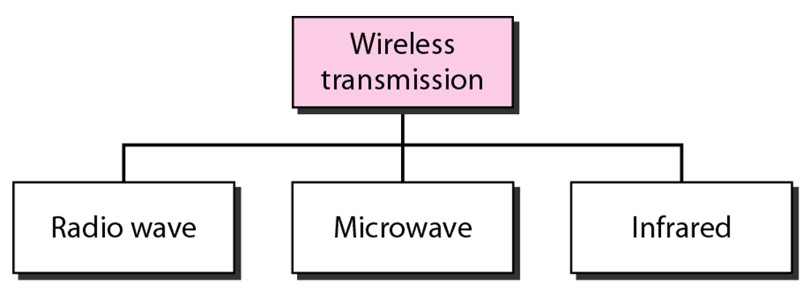
UNGUIDED MEDIA

Slide 23
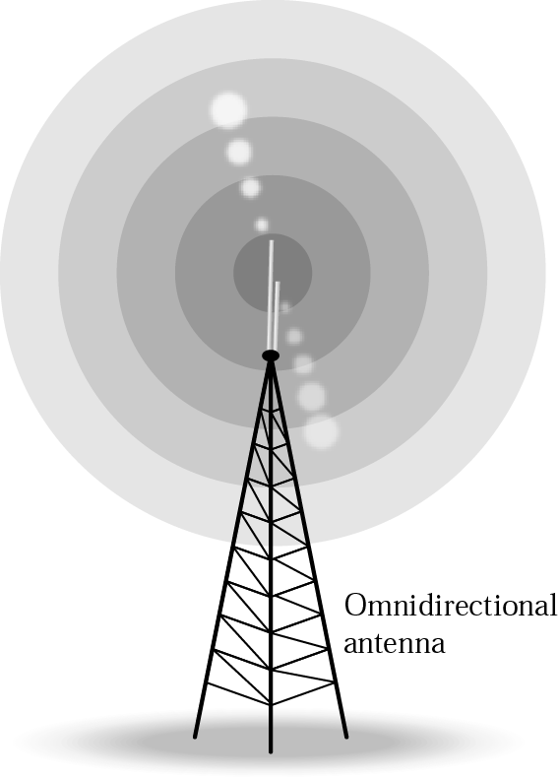
Radio waves
Frequency range- 30 MHz to 1 GHz
Omnidirectional in nature.
Can penetrate walls
Less sensitive to rainfall
Not Suitable for line of sight communication.

Slide 24
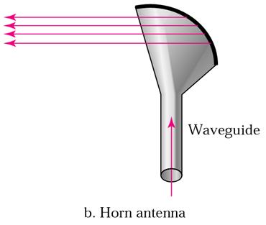
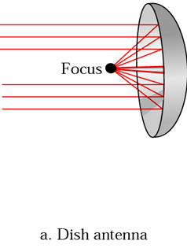
Microwaves
Frequency range 2GHz to 4 GHz
Highly Directional.
Suitable for point to point transmission

Slide 25
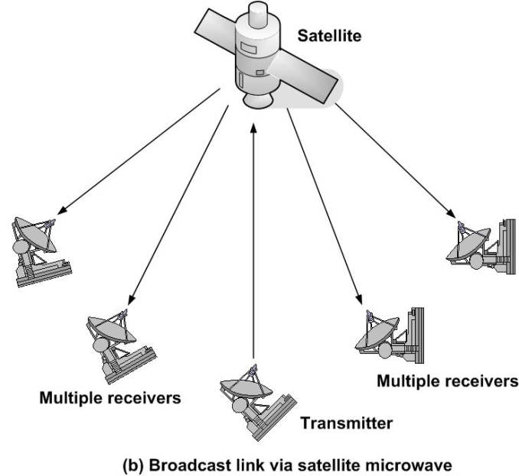
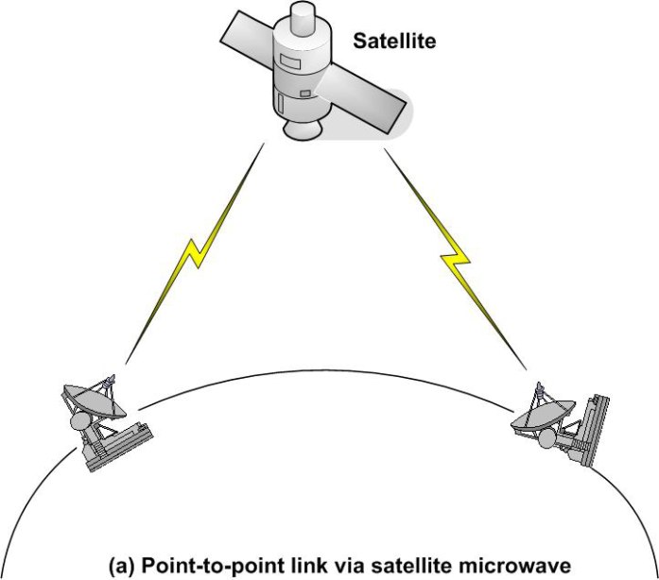
Satellite Communication
A communication satellite is basically a microwave relay station.
Used to link two or more earth stations.
Satellite communication configurations:
Point to point configuration
Broadcast configuration

